Slide 1
R.R. Smith Memorial Fund Foundation AGM September 29, 2024

Slide 2
Caroline Malm, Linda Watson, Dave Carter, Sarah Joyce, Barb Mikulec Steve Bailey, Gail Chaddock-Costello, Jim Reid, Karen Kilbride, Kerry Babiuk.

Slide 3
R.R. Smith Memorial Foundation Fund
Annual General Meeting Agenda
September 29, 2024 9:00 am
1. Welcome and Call To Order
2. Quorum Confirmed
3. Adoption of Agenda
4. Adoption of 2023 AGM Minutes
5. Business Arising from 2023 Minutes- if any
6. President’s Remarks
7. Adopt 2024-25 Draft Budget as printed in Delegates Package
8. Elections
FOR ELECTION: 8-1 Year positions for election
Steve Bailey (Sunshine Coast)
Dave Carter (Burnaby)
Gail Chaddock Costello (North Shore)
Laurence Greef ( Langley)
Sarah Joyce (Burnaby)
Karen Kilbride (Surrey)
Barbara Mikulec (Vancouver)
Jim Reid (Burnaby)
(two members will be appointed by BCRTA Board)
9. New Business
10. Adjournment

Slide 4
Motion: to approve the Agenda

Slide 5
Draft at 9 am at the Hilton Hotel, Richmond
. minutes-Annual General Meeting of the R R Smith Memorial Fund Foundation held on October 1, 2022
The president Barb Mikulec noted there was quorum of members.
She gave a First Nations Acknowledgement.
Motion # 1 M/S That the Agenda be adopted as circulated. Carried
Motion #2 M/S That the minutes of the 2021 AGM be adopted as circulated. Carried
The following individuals were acclaimed as Directors of the R.R. Smith Memorial Fund Foundation for the 2022/23 fiscal year:
Steve Bailey, Dave Carter, Gail Chaddock-Costello, Sarah Joyce, Lynne Farquharson, Karen Kilbride, Barbara Mikulec, Jim Reid Two further Directors will be appointed from the Board of the BCRTA.
Motion # 3 M/S That the draft budget as printed in the Summary of Reports be adopted. Carried
New Business:
Motion #4 M/S Marney Bethell, Troylana Manson
That the Kamloops Club of Retired teachers move ‘ that the R.R. Smith Memorial Foundation contribute additional funds to the six BC Universities R. R. Smith Bursaries annually.’
Treasurer Dave Carter spoke in reference to this motion. Then there was a motion of referral to the new R R Smith Board to discuss and report back. Carried
The AGM adjourned at 9:25 am.

Slide 6
Motion: to approve the Minutes

Slide 7
Motion
There was a motion at last AGM: that the R. R. Smith Memorial Foundation contribute additional funds to the six BC Universities annually.
Treasurer Dave Carter spoke in reference to this motion. Then there was a motion of referral to the new R. R. Smith Board to discuss and report back Carried.
After discussion with our lawyer, the Board discussed making contributions to the six universities R. R. Smith bursaries, but decided to instead focus on our charitable work under our criteria/application model as the bursaries were set up through a different source of funding after a strike action. Students apply directly to the universities, and the funds, through careful management, continue to grow.

Slide 8
President’s Letter 2024 The Board concludes another wonderful year. We appreciate the diligent contributions of time and energy of the Board members. We acknowledge with sincere gratitude the contribution of Board member Lynne Farquharson, who passed away recently and will be deeply missed. -The Board members met in person to discuss the issues for our charitable registered program, providing urgently needed funds in many developing countries and in BC. We ensure that all donations and the yearly contribution from members is spent wisely, ensuring transparency in the granting of funds, although we had many more requests for funds than we were able to support.
R. R. Smith Memorial Fund Foundation President’s Letter 2024
The Board appreciates the diligent contributions of time and energy of the Board members. Board members met in person to discuss the issues for our charitable registered program, providing urgently needed funds in many developing countries and in BC. We ensure that all donations and the yearly contribution from members is spent wisely, ensuring transparency in the granting of funds, as we had many more requests for funds than we were able to support. At the last AGM our funding was approved for $5 per member, donated once a year.
Careful management of the donations which are held through the Vancity Community/R.R. Smith fund with their office sending receipts promptly if donated on-line, and at year-end if donated by cheque. This year grants totaled over $43,000 which enables the continuation of programs helping registered charitable groups operating in BC and in developing countries with their diverse programs. The list of recipients was published in the earlier PostScript.
We discussed our bylaws and spent considerable time on this matter and now submit the updated bylaws for ratification to this AGM. We especially thank the Board members for their efforts updating the bylaws with the assistance of our pro bono lawyer Anders Ourom. Thanks also to Jim Reid for keeping our charitable status up to date with the government.
We continue to receive letters of appreciation from recipients from university students who benefit from the R. R. Smith bursaries administered through six universities, including UBC, SFU, UNBC, University of Victoria, Vancouver Island University and Thompson Rivers University. The Board discussed making contributions to the six universities R. R. Smith bursaries but decided to instead focus on our charitable work under our criteria/application model as the bursaries were set up through a different source of funding after a strike action. Students apply directly to the universities, and the funds, through careful management, continue to grow. We note a member has given a significant donation to five universities R. R. Smith bursary accounts this year.
Thanks to each of the members of our Board for sharing their skills: Kerry Babiuk, Dave Carter, Gail Chaddock-Costello, Laurence Greeff, Karen Kilbride, Sarah Joyce, Steve Bailey, and our BCRTA representatives Caroline Malm and Linda Watson. We appreciate Tim Anderson’s skill with the website. Special thanks to Kristi and Laurie at the BCRTA office.
Barb Mikulec, president

Slide 9
Continued
Careful management of the donations are held through the Vancity Community/R.R. Smith fund with their office sending receipts promptly if donated on-line, and at year-end if donated by cheque. This year grants totaled over $40,000 which enable the continuation of programs helping registered charitable groups operating in BC and in developing countries with their diverse programs. The list of recipients was published in the earlier PostScript.
We discussed our need to use our funds using the updated criteria and application forms on the website www.rrsmith.ca Thanks especially to our treasurer Dave Carter for keeping our charitable status up to date with the government.
We continue to receive letters of appreciation from fund recipients from university students who benefit from the R. R. Smith bursaries administered through six universities, including UBC, SFU, UNBC, University of Victoria, Vancouver Island University and Thompson Rivers University

Slide 10
continued
The Board consults with our lawyer Anders Ourom about legal issues which could affect our charitable status, ensuring we follow the guidelines as a Canadian charitable entity. He consults with us as a pro bono initiative which is greatly appreciated. His mother was a teacher librarian in the Vancouver school district.
Thanks to each of the members of our Board for sharing their skills: Dave Carter, Gail Chaddock-Costello, Karen Kilbride, Sarah Joyce, Steve Bailey, and our BCRTA representatives Caroline Malm and Linda Watson. We appreciate Tim Anderson’s skill with the website. Special thanks to Kristi and Laurie at the BCRTA office.
Barb Mikulec, president

Slide 11
R. R. Smith Memorial Foundation Fund
Background: Mr. Robert Reid Smith was a founding member of the BC Retired Teachers Association and President of the BCTF, and who died in 1969. He was instrumental in planning for retired teachers needs such as housing.
In 2000 the R. R. Smith Memorial Fund Foundation was established “to advance public education in BC and in developing countries.”
Presently an annual fee of $2 from each member funds the R R Smith Memorial Foundation Fund.
Donations to the R. R. Smith Memorial Foundation Fund will receive charitable receipts. 86160 2126 BC0001
Our website is www.rrsmith.ca

Slide 12
R. R. Smith Board 2023-2024
Kerry Babiuk Steve Bailey
Dave Carter Gail Chaddock-Costello
Sarah Joyce Karen Kilbride
Barb Mikulec Jim Reid
BCRTA reps: Carolyn Malm Linda Watson

Slide 13
Criteria for applying- R R Smith Memorial Fund- Building an Educational Legacy
The purposes of the R.R. Smith Memorial Fund Foundation focus on the advancement of public education in British Columbia, other parts of Canada and developing countries. The Foundation awards one year grants under the following provisions of its constitution in order to advance its charitable mandate:
The Foundation administers grants to British Columbia or Canadian registered charitable organizations in order to:
Support the acquisition of school supplies, books and equipment to enhance learning for students and teachers;
Support innovative projects which advance public education;
Support the development of education programmes in developing countries
The Foundation does not fund salaries, food programmes, or the construction of buildings or playground equipment such as climbing apparatus, swings or slides.
The foundation will co-fund initiatives with governments in Canada, developing countries, and other charitable organizations.
When making an application for an R.R. Smith Memorial Fund grant, please provide the following contact information:
Date of application submission: ______________________________
Name of contact person: _______________ Name of organization:_____________
Telephone Number:_______________________ Email address:__________________________
Mailing Address:________________________________________________________________
Note: Applications for university bursaries are managed by universities directly and must be
completed through direct communication with the university.

Slide 14
Grant Application
Name of the organization making the application: ____________________________________________________________________________
British Columbia Registered Charity Number or Canadian Registered Charity Number:_______________ (please circle one of the following: BC Charity# Canadian Charity#)
Description of the organization and its activities:
______________________________________________________________________________
Please provide an outline of the specific project or initiative to be funded:
______________________________________________________________________________
Amount requested to contribute to the funding of the project or a specific aspect of the project:
______________________________________________________________________________
Please attach a budget for the project or initiative.

Slide 15
2024 Funds disbursed total $44,000
African Canadian Continuing Education Society
BC Heritage Fairs Society
Bright Beginnings Foundation Fund (DAF6127)
Canadian Friends of Oaxaca Inc.
Canadian Harambee Education Society
Canadian Women for Women in Afghanistan
Children's Care International
CoDevelopment Canada Association
Compassion Fruit Society
Days for Girls Canada Society
Families for Children

Slide 16
Grants continued
For the Love of Africa Society
InnovativeCommunities.org Foundation
Kenya Education Endowment Fund
NITEO Africa Society
One Girl Can Society
Pacific Community Resources Society (PCRS)
Real Humanitarian
Step International Foundation
Tumaini Fund Canada
Umoja Operation Compassion Society
Victoria-Taiama Partnership (Society)
Wonderful World of Books
 |  | ######

Slide 17
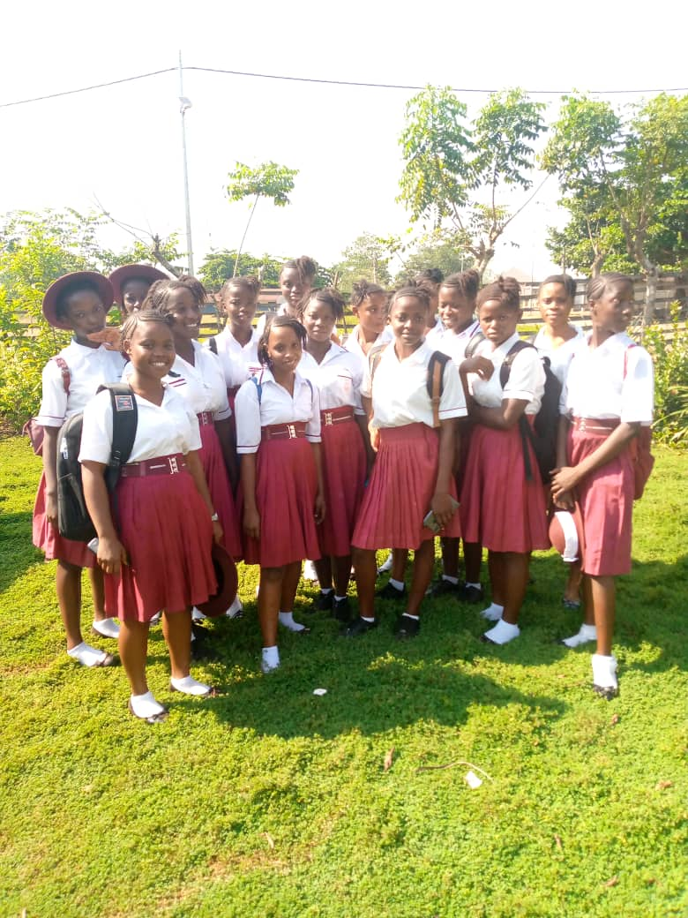
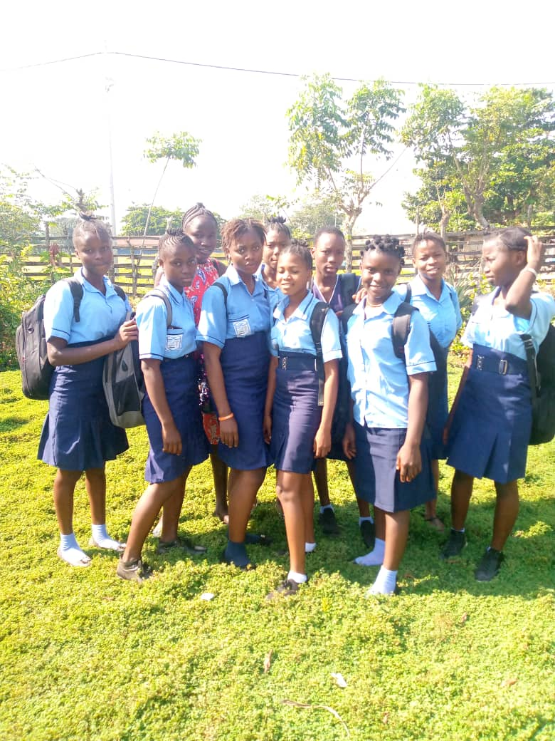
Victoria-Taiama Partnership
Tunics and uniform skirts for students-made in tailoring class

Slide 18
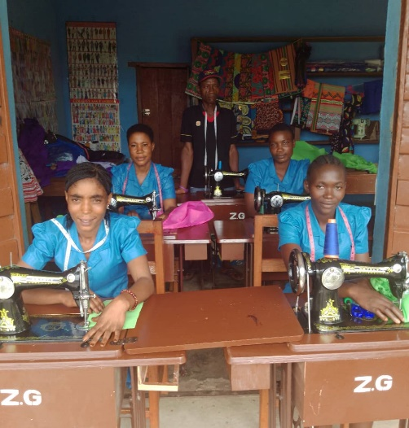
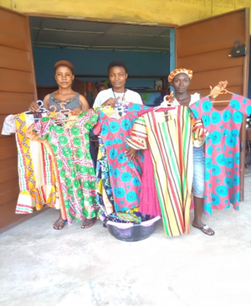
Sewing class, when students complete the course, the girls are given their machines to take home.

Slide 19
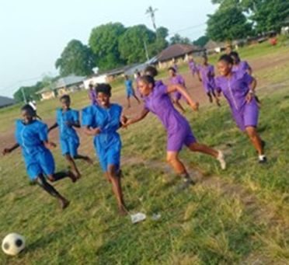
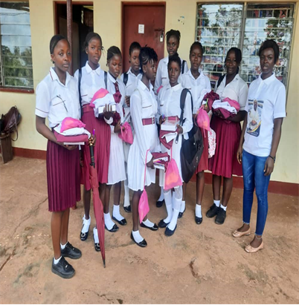
Students receive supplies for Secondary School Program

Slide 20
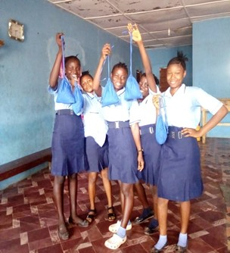
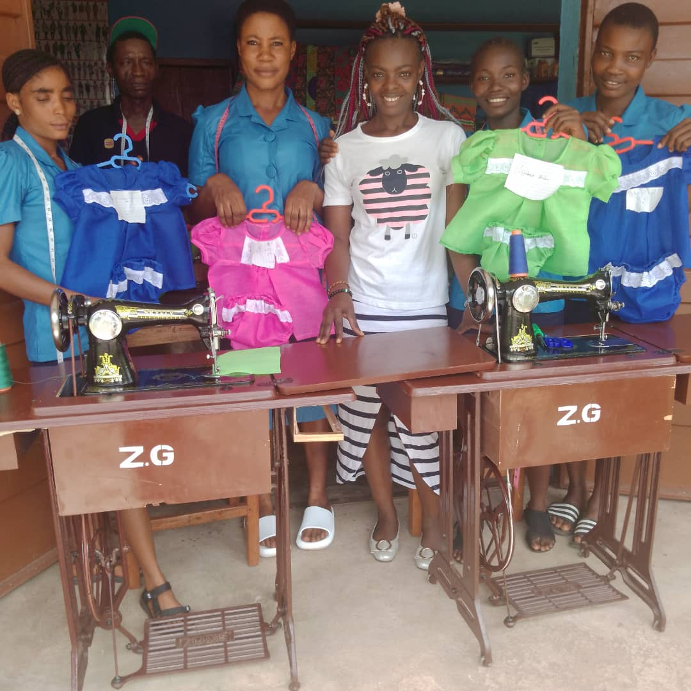
Thank you so much for your ongoing support of our project! I have attached some photos of the sewing program that you are supporting through your $2,000 grant. The 2022-23 group of students will graduate in May, and have completed several projects, including baby clothes, dresses and robes, school uniforms and personal kits consisting of a draw string bag containing menstrual pads, underwear and a washcloth.

Slide 21
Guatemala school books

Slide 22
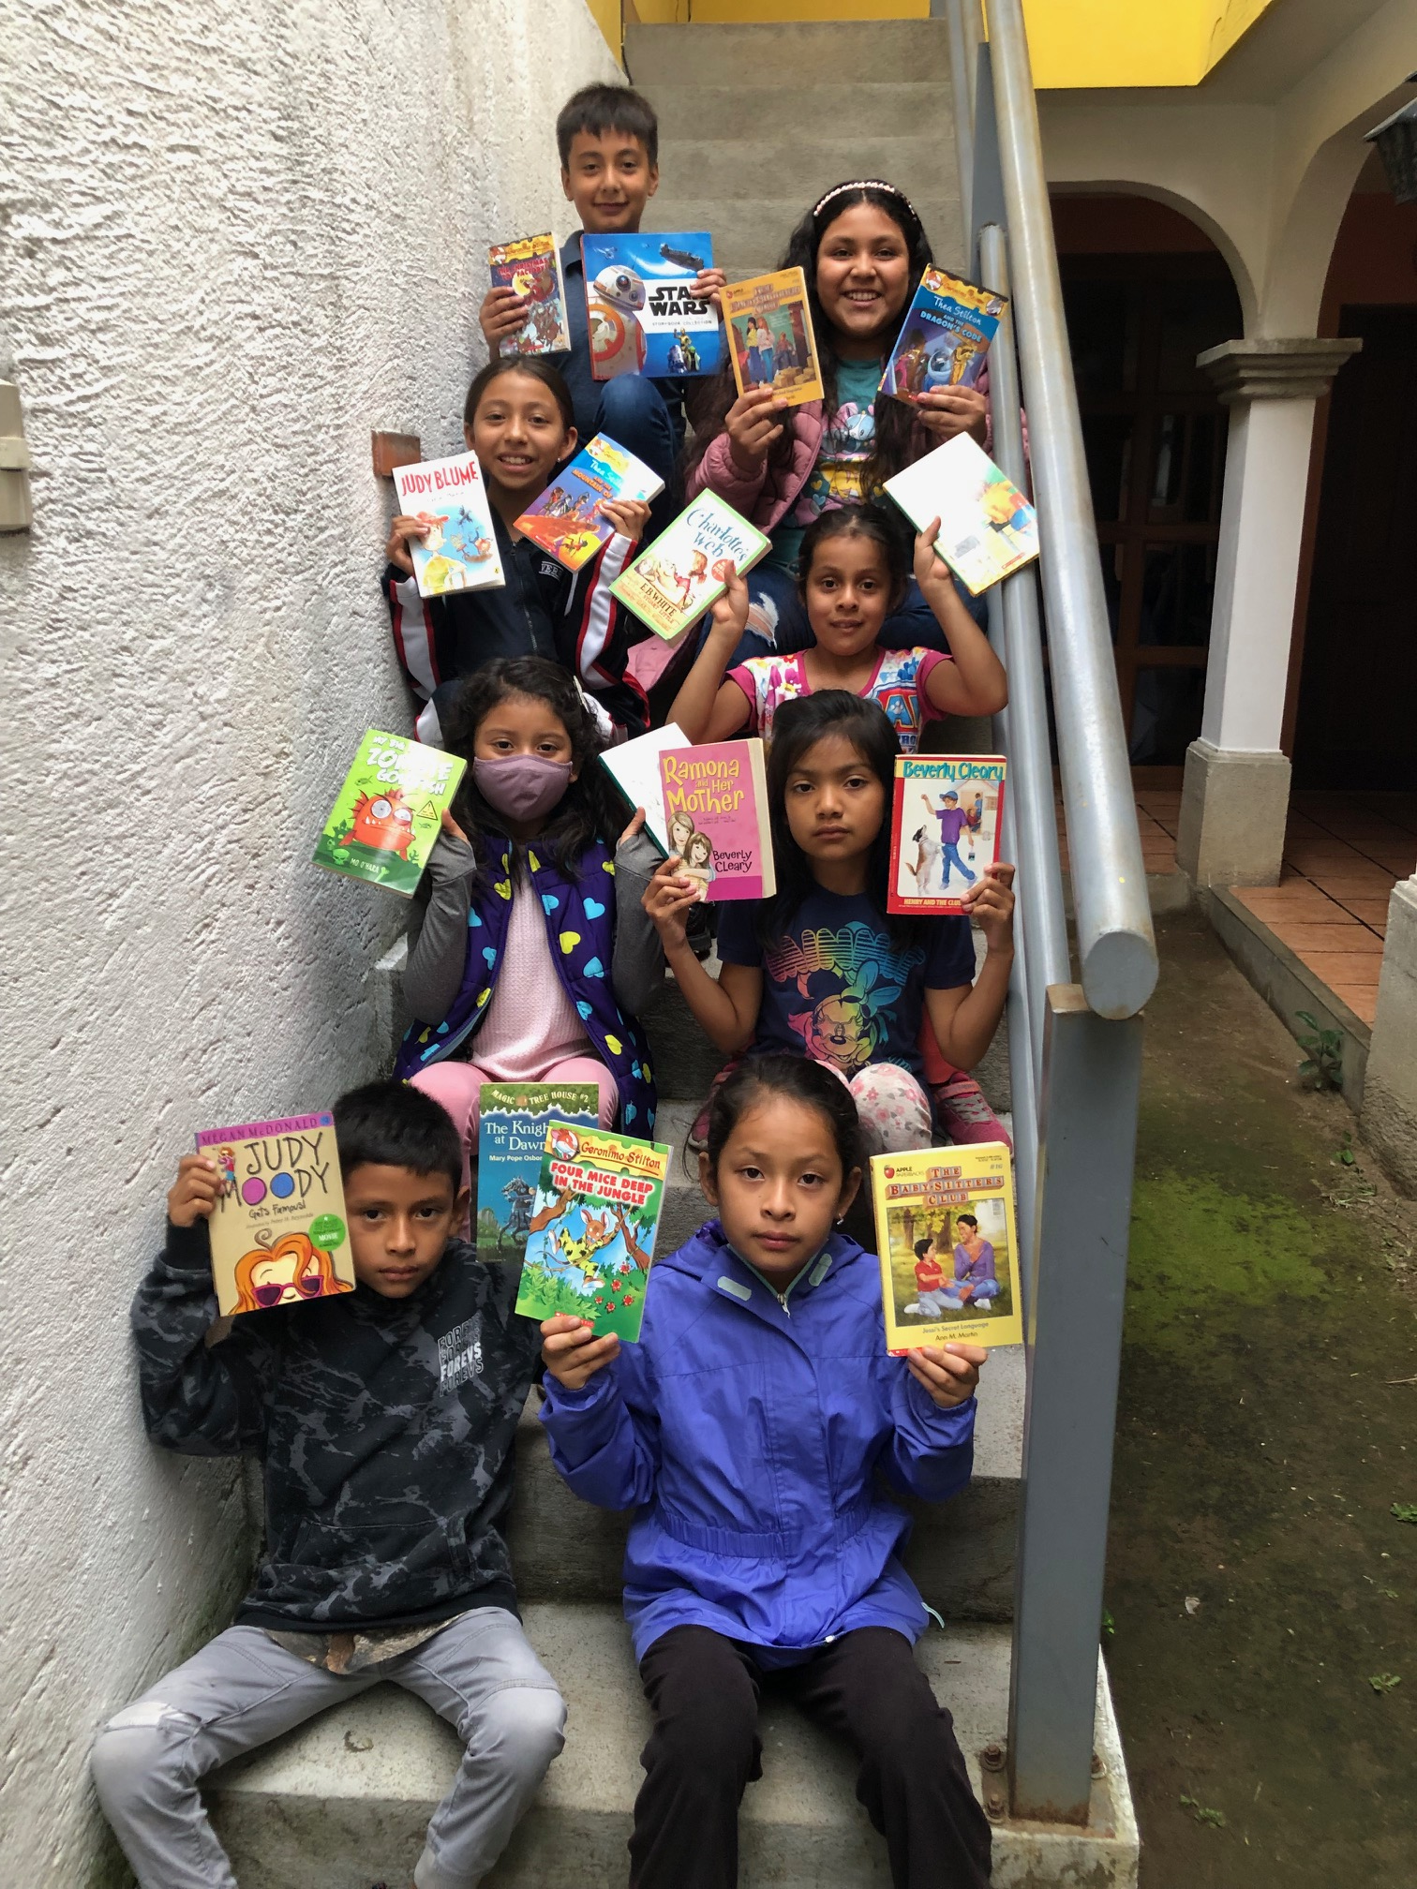

Slide 23
Literacy for students

Slide 25
Treasurer’s report June 30, 2023 Draft budget
R.R. Smith Community Fund Budget for the 2023 AGM
The R.R. Smith Committee has had a very busy year ending on June 30, 2023. There were 33 applications for grants and $40 800.00 were approved. The requests for support were 2-3 times the available budget and so a number of organizations had their appeals reduced significantly. Many of the requests this year were from first time applicants and most will probably ask for funding next year as well.
Not only is the number of requests growing, and therefore the money needed to meet those requests, but the variety of submissions has increased as well. Requests are granted to many parts of Africa, India, Pakistan, Central America, Afghanistan and also to projects in British Columbia. Some of the grants were given for computer tablets, sewing machines, menstrual supplies, musical instruments and sporting goods.
The R.R. Smith Committee move an increase in the annual fee from $2.00 to $5.00. This would enable the Committee to grant a larger amount to the present organizations, be able to provide additional support to many worthy projects and allow a top-up for the Capital Fund. The Capital Fund collects interest on investment monies from the VanCity Community Foundation which provide a more robust source of ongoing self-sustaining funding over time.

Slide 26
Draft RR SMITH PROPOSED BUDGET JUNE 3, 2024 – JUNE 30, 2025
CAPITAL & BUSINESS FUNDS
Balance June 3, 2024 239,303.88
Business Fund 273.46
Shares 228.73
SHARE OF CAPITAL FUND
RR Smith MFF 204,242.70
Friends of Abbotsford DRTA 6,500.00
Friends of North Shore RTA 2,100.00
Friends of Vancouver RTA 26,461.18
ANTICIPATED REVENUE FOR 2024-2025
Membership Fees 69,500.00
Interest on Capital 32,000.00
Bequests 53,000.00
Donations 5,000.00
ANTICIPATED EXPENSES FOR 2024-2025
Grants (RR Smith & Friends) 70,000.00
AGM 1,000.00
Board Expenses 1,500.00
Bank Fees 4,500.00
Jim Reid-Treasurer-R.R. Smith Community Budget

Slide 27
Motion: to approve the draft budget

Slide 28
Bylaws for ratifying-motion

Slide 29
R. R. Smith Election Candidates 8 to be elected
Kerry Babiuk
Steve Bailey
Dave Carter
Gail Chaddock-Costello
Laurence Greeff
Sarah Joyce
Barbara Mikulec
Jim Reid

Slide 30
Motion: to approve the candidates for a one year term on the R. R. Smith Board

Slide 31
Thank You

